Slide 1
The Portrayal of Feminism in the Poetry of Alfonsina Storni
By: Ana Oropeza
WLC 400 Spring 2015
Advisors: Dr. Donaldo Urioste and Dr. Rafael Gómez

Slide 2
Abstract
The purpose of this essay is to discuss and analyze the feminist poetry of the Argentine poet Alfonsina Storni, and to examine how her poems "Tu me quieres Blanca" [You want me White], "Hombre pequeñito" [Little, Little Man] and "La que comprende" [She Who Understands] defend and reaffirm the rights of women, and reflect the feminist movement in Argentina during the early twentieth century. I address the influences that made Storni rebel against the rules imposed by society on women. Via her poetry, I demonstrate how women of that era felt trapped in the face of injustice and inequality. Storni exposes the horrible condition of women in Argentine and Spanish American societies, and demands justice and dignity for all women. In this light, Storni defies the norms of Argentine society and exposes the oppression generated by men over women.

Slide 3
Research Questions
What is the women’s role in Latin America society in early twentieth century?
How does Alfonsina react to the role of “ La Señorita”?
How does Alfonsina Storni portrayals feminism in her literary works?

Slide 4
Why did I chose this topic?
I chose this topic because…
I wanted to learn about how women have been depraved of equal rights.
I wanted to discover what inspired women to become feminist writers.

Slide 5
Significance of my Study
My investigation demonstrates how Alfonsina Storni represents women who have no voice in a system where men have had all power. At the beginning of the twentieth-century, she defied Argentine society by exposing and rejecting men’s disregard for women. Storni breaks the moral and social rules in her poetry where she exposes men’s disregard toward women which is relative to their attitude and treatment to women.

Slide 6
Definitions
Feminism:
The advocacy of women's rights on the grounds of political, social, and economic equality to men.
Patriarchy:
A system of society or government in which men hold the power and women are largely excluded from it.
Machismo:
Strong or aggressive masculine pride.

Slide 7
Feminist Women in Literature during the XX Century
Gabriela Mistral, Juana de Ibarbourou and Alfonsina Storni.
The central idea in their literary works was the role of women in society.

Slide 8
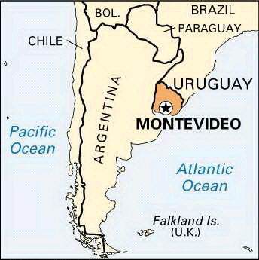
In 1938, These three great figures feminists met in the university of Montevideo, Uruguay to give a lecture to the students about how creating poetry and of the roll that they give him to the woman in his poetry.
Its encounter caused history because their work was not accepted in their country of origin and even so they transcended opposite by their controversial message against the rules imposed by men.

Slide 9
Storni was most outstanding between the three because…
Her criticism towards men was more direct and strong
She freely talk about issues that Mistral and Ibarbourou did not dare to speak so openly
She was the most prominent in controversial issues like sex and love

Slide 10
The image of “La Señorita” in Latin America
Candidate to become a wife
Takes care of her moral reputation
“Virginity” was seen as the most important thing in a woman
A women who maintains a good reputation will be “blessed to have a husband”

Slide 11
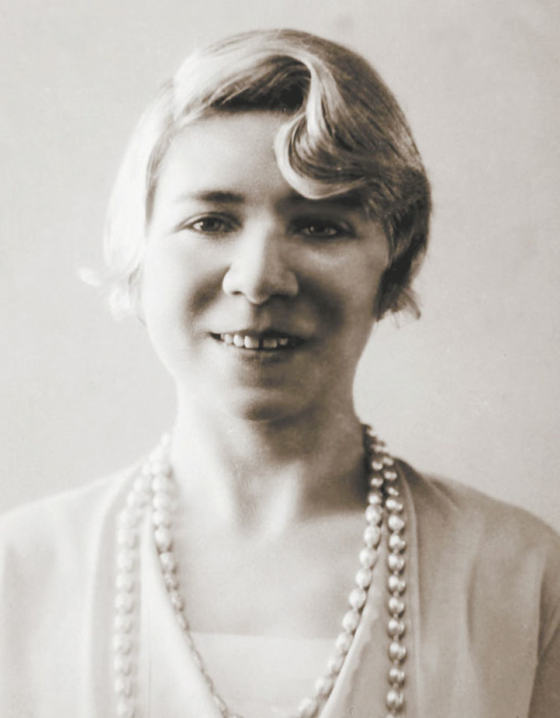
Alfonsina Storni
She was a born on May 29, 1892-October 25, 1938
Even though she was born in Switzerland, she is considered an Argentine poet because she was raised there since childhood
Her family was Swiss and they joined the wave of European immigrants who emigrated to Argentina in 1880
She was the fourth child
The family had financial problems that lead her to start working at the age of eleven and give up studying

Slide 12
At the age of fourteen she was part of a theatrical troop directed by Manuel Cordero and traveled throughout Argentina.
She managed to continue her studies and in 1910 she became a teacher
She worked for a local magazine where she began to write and publish her writings
At the age of twenty, she got pregnant by a man twenty-five years older than her and who was married
Storni moved to Buenos Aires, Argentina with her son Alejandro
Storni knows that she will face strong criticism due to her unwealthy mother status. For this reason she was determined to confront the moral prejudices

Slide 13
Her arrival in Buenos Aires was not easy but thanks to his talent and interest in writing might work in many places to support his son
In 1916, her great talent in writing poetry, she chooses writing as a profession and thus managed to publish his first book, entitled “La inquietud del rosal”, which was not very successful. It was not until her next publication, entitled “ El dulce daño’’, and her poem “Tú me quieres blanca’’, which was well received by intellectuals in Argentina
In 1919, she published her next books titled “Irremediable” and “Languidez”
Her fame continued to grew as she wrote for important journals like “La Nota” and “La Nación” were she used the Lao Tao pseudonym. In this section of the newspaper she defends the rights of women and continues to spread her femenist message through her poems

Slide 14
“Tú me quieres blanca”
“Hombres Necios”

Slide 15
“Tú me quieres blanca” 1918
Tú me quieres alba,
me quieres de espumas,
me quieres de nácar.
Que sea azucena
Sobre todas, casta.
De perfume tenue.
Corola cerrada .
You want me dawn,
You want me sea foam,
You want me mother of pearl
To be a lily
Above all, chaste.
Of faint perfume.
An unopened blossom.

Slide 16
“Hombres Necíos”
Hombres necios que acusáis
a la mujer sin razón,
sin ver que sois la ocasión
de lo mismo que culpáis:
Silly, you men-so very adept
at wrongly faulting womankind,
not seeing you're alone to blame
for faults you plant in woman's mind.
Translated by: Alan S. Trueblood

Slide 17
Sor Juan Inés de la Cruz
She was born on November 12, 1651 and died on April 17, 1695 in Mexico City
Sor Juana Ines de la Cruz in the seventeenth century chose to avoid the role of wife and mother to enter a convent to study
She wrote an autobiographical document which bears the title “Respuesta a Sor Filotea de la Cruz” in which defends the right of every woman primarily their right to study
Considered the first feminist in Latin

Slide 18
“Tú me quieres blanca”
You want me dawn,
You want me sea foam,
You want me mother of pearl
To be a lily
Above all, chaste.
Of faint perfume.
An unopened blossom.
Not even a moonbeam
To caress me.
Nor a daisy
that may call herself my sister.
You want me snow,
You want me white,
You want me dawn.

Slide 19
You who had all
The drinks at hand,
With lips stained
From fruits and honey.
You who were in the feast,
Who were covered with leaves,
Who destroyed the flesh
To celebrate Bacchus.
You who in the black
Gardens of deception
Dressed in red
Ran to ruin.
You who still preserve
Your skeleton.
I don’t even know
For what miracles
You expect me white
(May god forgive you),
You expect me chaste
(May god forgive you),
You expect me dawn.

Slide 20
Run away to the forest
Leave for the mountains;
Clean your mouth;
Live in the shacks;
Touch with your hands
The wet earth;
Feed your body
With bitter root;
Drink from the rocks,
Sleep on the frost;
Renew your flesh
With salt and water;
Speak with the birds
And get up with dawn.
And when your flesh
Returns to you,
And when you have put
In it the soul,
Which in the bedroom
Was left tangled,
Then, good man,
Expect me white,
Expect me snow,
Expect me chaste.

Slide 21
And when your flesh
Returns to you,
And when you have put
In it the soul,
Which in the bedroom
Was left tangled,
Then, good man,
Expect me white,
Expect me snow,
Expect me chaste.
Translated by Melissa Gioia and Laura Hakala

Slide 22
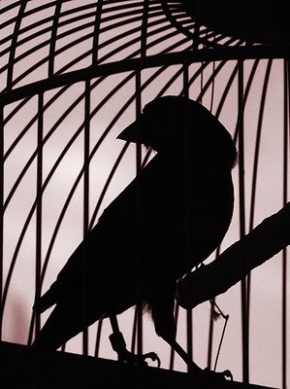
“Hombre Pequeñito”
Little little man, little little man,
set free your canary that wants to fly.
I am that canary, little little man,
leave me to fly.
I was in your cage, little little man,
little little man who gave me my cage.
I say "little little" because you don’t understand me
Nor will you understand.
Nor do I understand you, but meanwhile,
open for me the cage from which I want to escape.
Little little man, I loved you half an hour,
Don’t ask me again.
Translated by http://allpoetry.com/Little-Little-Man

Slide 23
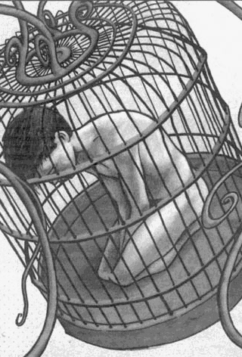
Symbolism
Canary:
Represents women.
Cage:
Represents the norms of society
The ignorance of men
Oppression

Slide 24
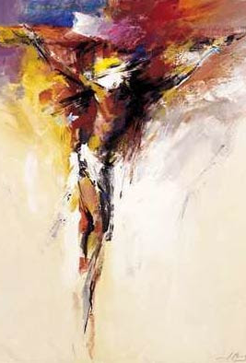
“La que comprende”
With her black hair fallen forward,
The beautiful woman, of middle age,
Is prostrate on her knees, while Christ in agony
From his wooden cross looks down upon her with pity.
In her eyes the burden of an enormous sadness,
In her breast the burden of a child to be born,
At the foot of the pale bleeding Christ she prays:
"Lord, let not my child be born woman!”
Translated by Kate Flores

Slide 25
Works Cited
"CVC. Alfonsina Storni. Biografía." CVC. Alfonsina Storni. Biografía. Instituto Cervantes (España), 2006. Web. 13 May 2015. <http://cvc.cervantes.es/actcult/storni/biografia.htm>.
"El Avance De Los Derechos De La Mujer En El Siglo XX." Educ.ar. Ministerio De Educación, 23 Mar. 2012. Web. 13 May 2015. <http://www.educ.ar/recursos/ver?rec_id=70048>.
Fariña Busto, María Jesús. "DE PURO CUERPO A UN CUERPO PROPIO. TEXTUALIZACIONES DEL DESEO EN ALGUNAS ESCRITORAS HISPÁNICAS." Versants (Suiza) 2003: 243-59. Web. 13 May 2015.
Garrido, Lorena. "Nº 28." Storni, Mistral, Ibarbourou: Encuentros En La Creación De Una Poética Feminista. Documentos Lingüísticos Y Literarios 28, 2005. Web. 13 May 2015. <http://www.humanidades.uach.cl/documentos_linguisticos/document.php?id=90>.
"Hombre Pequeñito by Alfonsina Storni." - Famous Poems, Famous Poets. All Poetry, n.d. Web. 13 May 2015. <http://allpoetry.com/Hombre-Pequeito>.
Mora, Ana. "Alfonsina Storni: La Mujer Y La Ciudad." Association of Hispanic Feminine Literature. Letras Femeninas, 2008. Web. 21 Apr. 2015. <http://www.public.asu.edu/~sev1987/Letrasfem/n_especial.html>.
"Real Academia Española." Real Academia Española. N.p., n.d. Web. 13 May 2015. http://www.rae.es/.

Slide 26
"Rosas Y Rosas... (Homenaje a Mis Poetas)." : La Que Comprende.. (Alfonsina Storni). Mis Poetas, 6 Oct. 2008. Web. 13 May 2015. <http://mispoetas-cani.blogspot.com/2008/06/la-que-comprende-alfonsina-storni.html>.
"Tú Me Quieres Blanca - Alfonsina Storni - Ciudad Seva." Tú Me Quieres Blanca - Alfonsina Storni - Ciudad Seva. Ciudad Seva, n.d. Web. 13 May 2015. <http://www.ciudadseva.com/textos/poesia/ha/storni/tumequi.htm>.
Vallejo, Catharina De. "La Imagen De Lo Femenino En La Lírica De Los Poetas Del Romanticismo Hispanoamericano: Inscripción De Una Hegemonía." La Imagen De Lo Femenino En La Lírica De Los Poetas Del Romanticismo Hispanoamericano (n.d.): n. pag. Centro Virtual Cerventes. Thesaurus, 1993. Web. 1 May 2015. <http://cvc.cervantes.es/lengua/thesaurus/pdf/48/TH_48_002_104_0.pdf>.
Zapata De Aston, Arcea. "De Una Sujeto Femenina a Una Sujeto Mujer Critica Pedagogías Del Cuerpo En Languidez Y Ocre De Alfonsina Storni." Perífrasis. Facultad De Artes Y Humanidades, 02 Aug. 2014. Web. 13 May 2015. <http%3A%2F%2Frevistaperifrasis.uniandes.edu.co%2Findex.php%3Foption%3Dcom_content%26view%3Darticle%26id%3D194%253Ade-una-sujeto-femenina-a-una-sujeto-mujer-critica-pedagogias-del-cuerpo-en-languidez-y-ocre-de-alfonsina-storni%26catid%3D38%253Aindice%26lang%3Des>.

Slide 27
Thank you!!!

